Slide 1
CS 501 – Spring 2020
Final Project Presentation
JavaFX application
Computer Graphics and Animation
Final Project IV
Jenelee Adames
Supriti Garnaik
Vaishnavi Gopalakrishnan
- Graduate Students

Slide 2
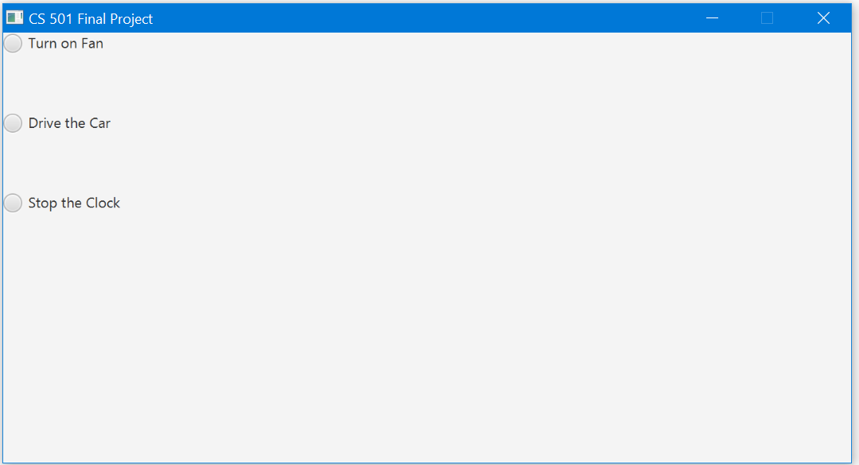
Final Project IV
Chapter 15
All the files in the package consists of
JavaFX libraries.
Main.java
Compiles the other three files together
to visualize the computer graphics and
animation.
Fan.java
Car.java
Clock.java

Slide 3
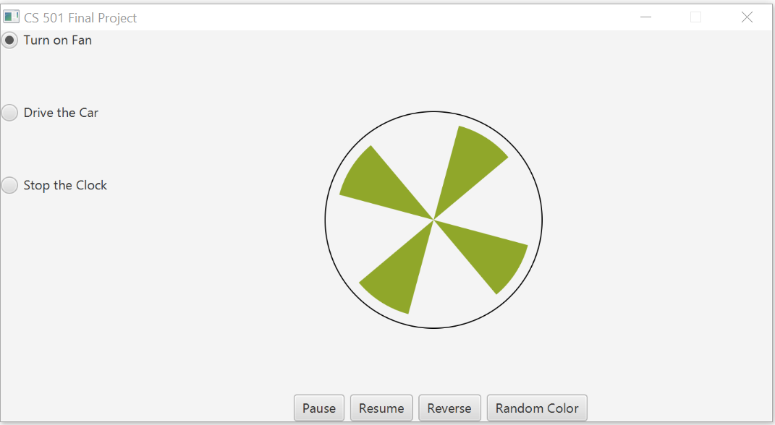
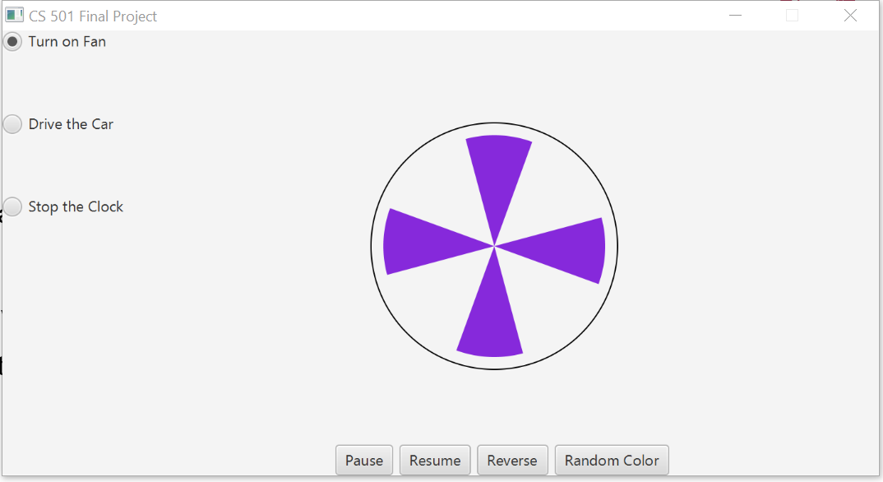
Fan.java
Displaying a running fan
This program that displays a running fan.
Pause button to pause the fan.
Resume button to resume the stopped fan.
Reverse button reverse the running fan.
Random Color button will change the color
of the fan blades.

Slide 4
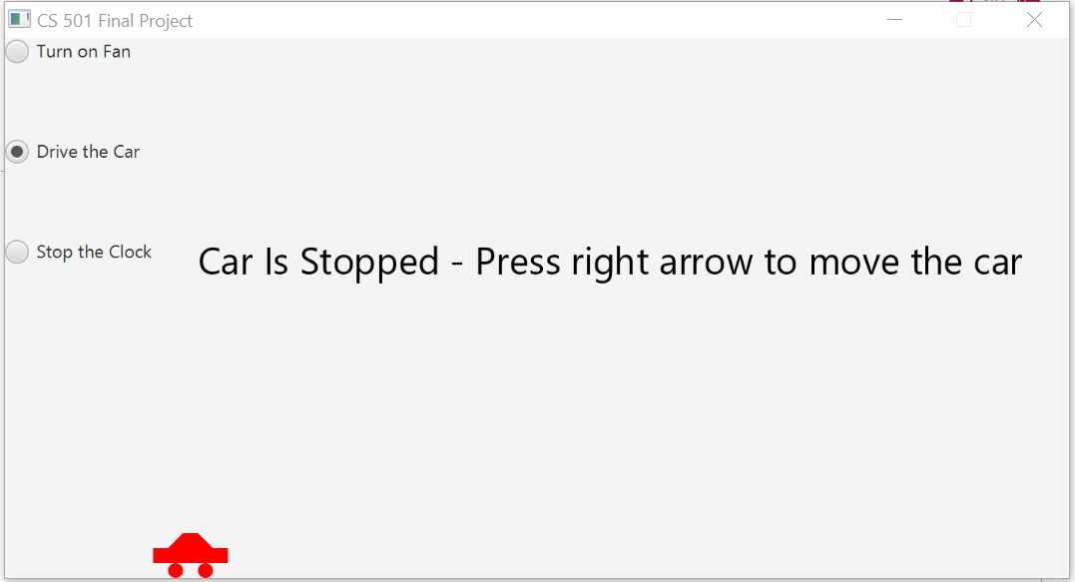
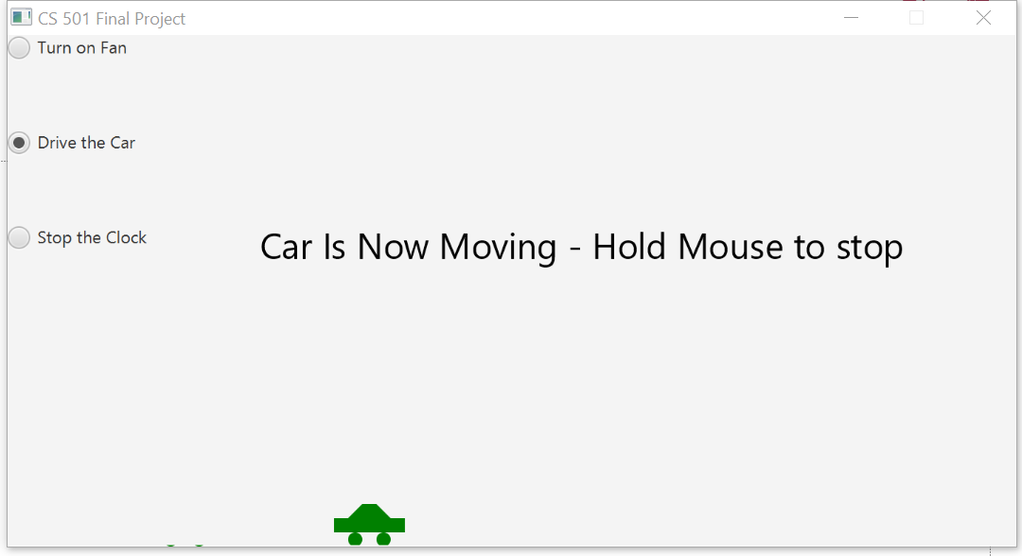
Car.java
Racing Car
This program simulates car racing
The car moves from left to right
When it hits the right end, it restarts from the
left and continues the same process
Also we can pause/resume the animation
with mouse button press/release
We can increase/decrease the car speed by
pressing the Left and Right arrow keys
It has corresponding texts shown
When the car runs, it will be green
When it stops, it will be red

Slide 5
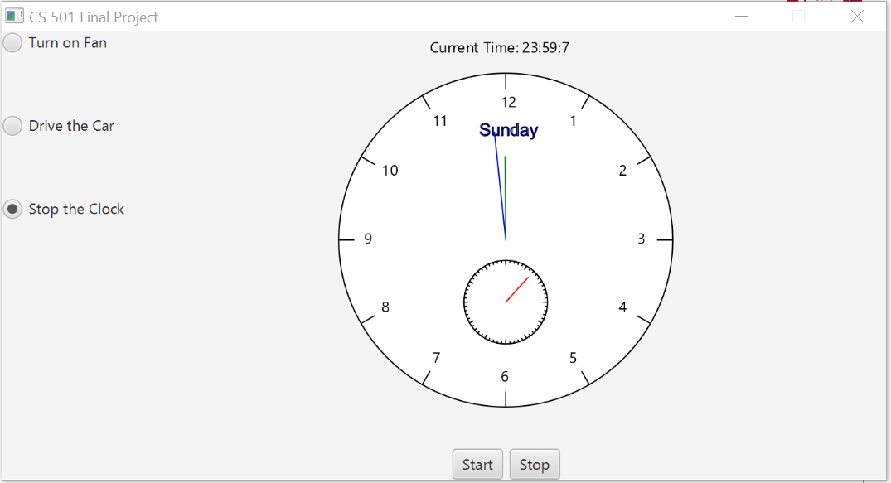
Clock.java
Control a clock
This program adds animation
to start and stop the clock
It lets us control the clock with the Start
and Stop buttons
Even if we stop the clock and start after
three seconds, it will automatically start
after 3 seconds with the current time

Slide 6
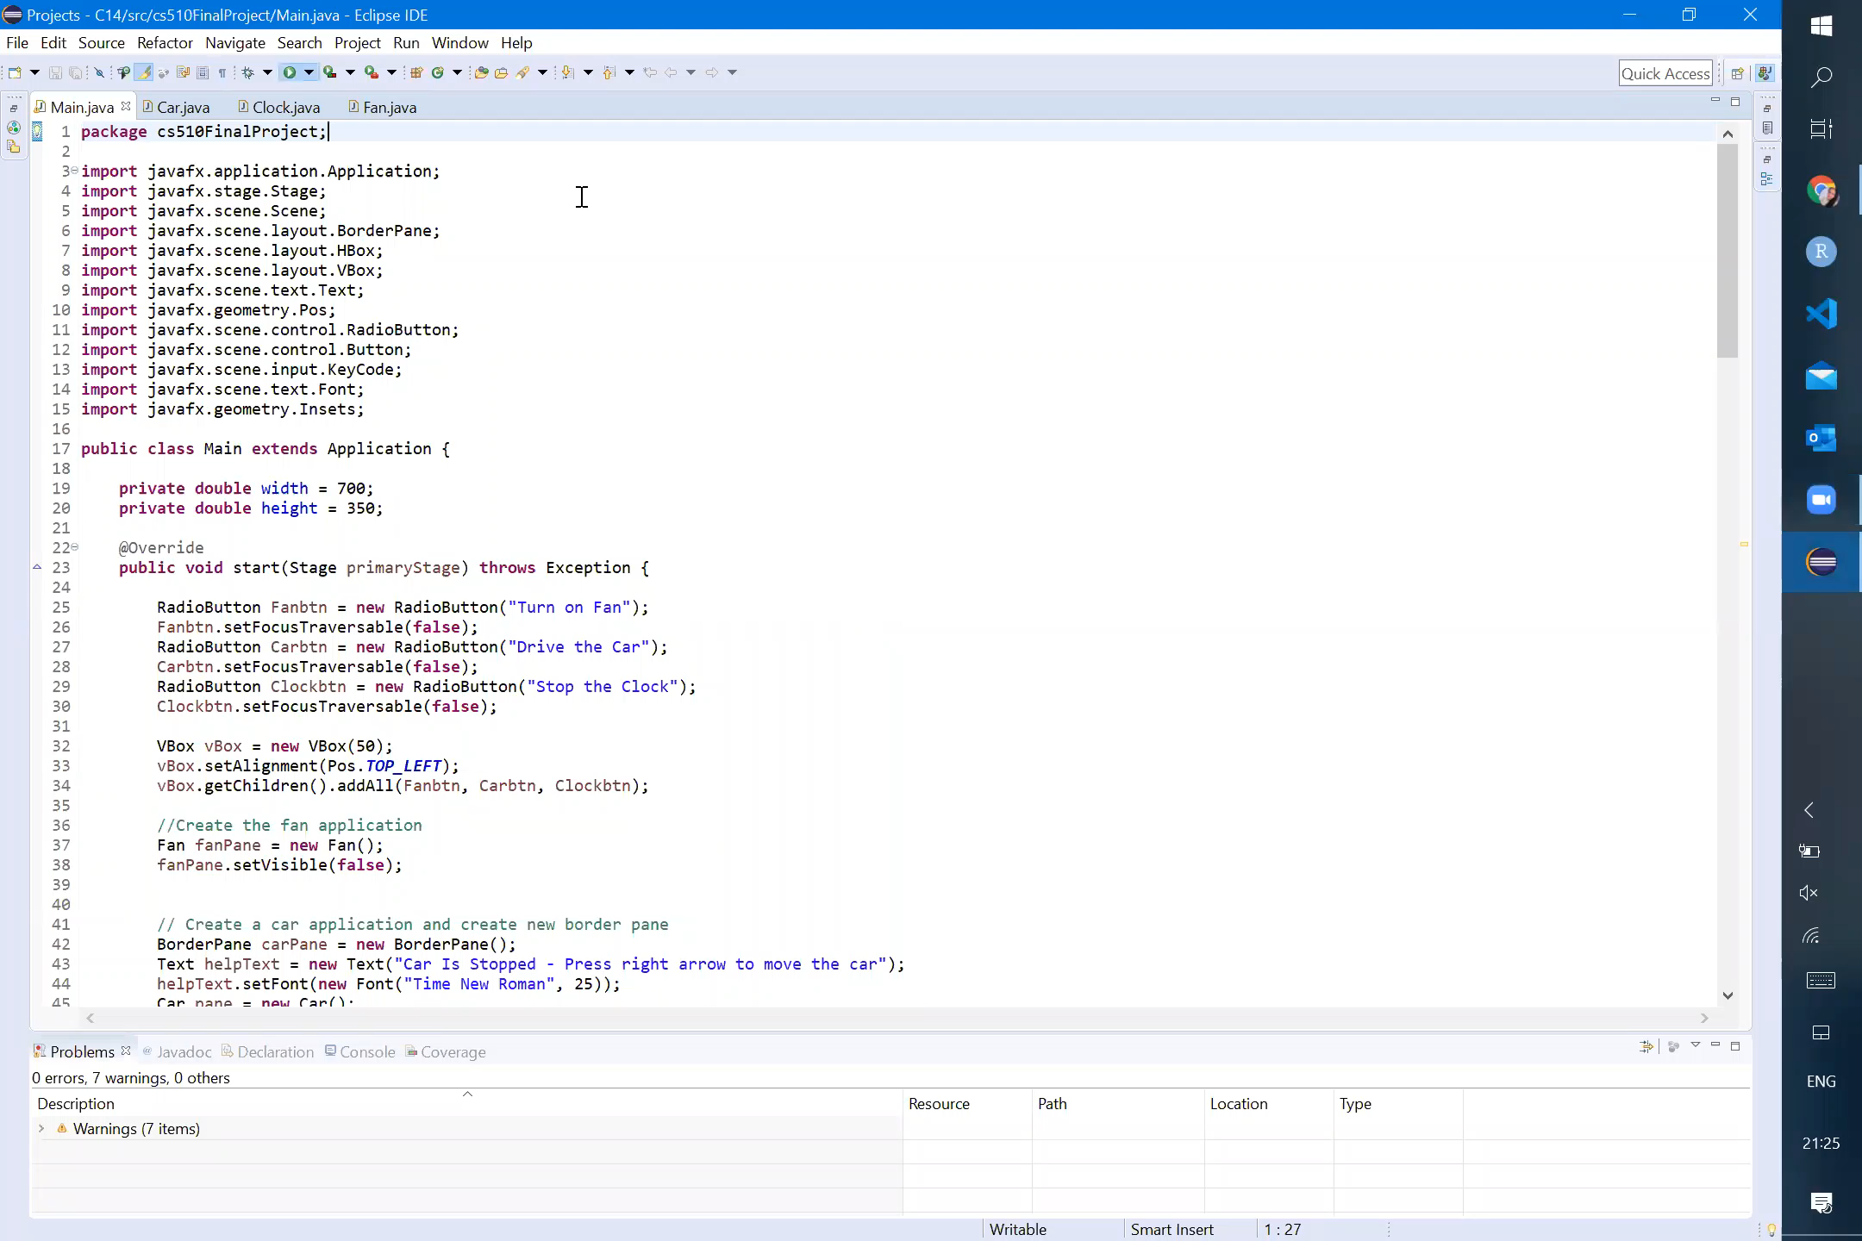
Working of the application

Slide 7
GitHub Repository:
https://github.com/vaishnavimecit/CS501-FinalProject
Thank You

